Slide 1
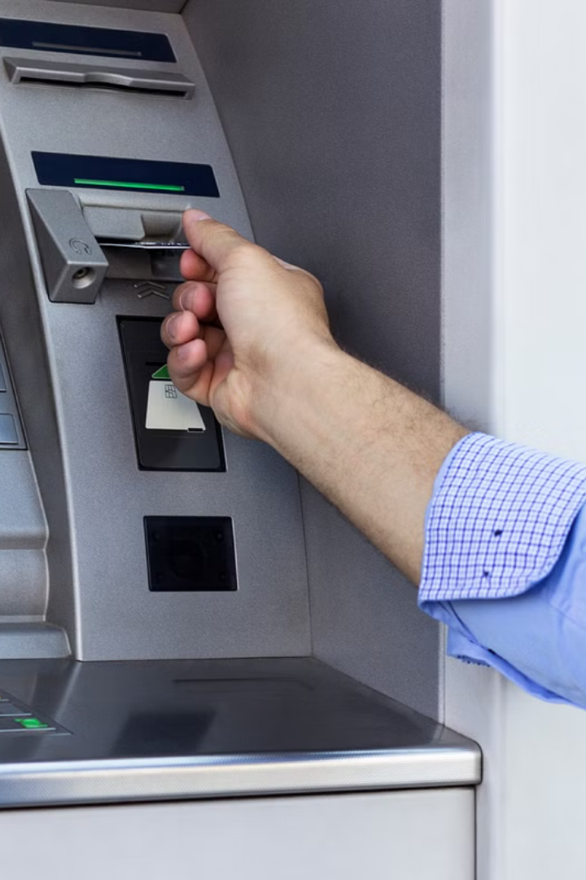
MINI ATM SYSTEM
(USING C LANGUAGE)
PROJECT BY:
AAYUSH SAVALIYA (24AIML057)
MAHEK SARADVA (24AIML056)
MESHVA PATEL (24AIML041)

Slide 2
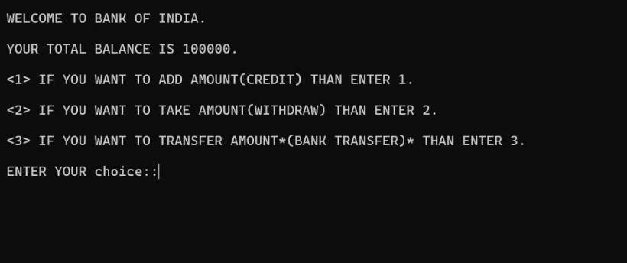
CODE OVERVIEW
Main menu :
📝
Displays three options for the user:
Add money (Credit).
Withdraw money (Debit).
Transfer money between two accounts.
Based on the choice, the program performs the corresponding action.

Slide 3




(1) Crediting the money.
Credit Option '1.'
PIN Verification
Transaction Confirmation
When the user selects 'Credit', they can add money to their account. The system implements a daily limit of 100,000 to prevent excessive deposits.
PIN verification is a crucial security measure. The system prompts the user to enter their PIN. Three incorrect attempts result in a 24-hour lockout to protect against unauthorized access.
Once the PIN is verified, the user enters the amount to credit. The system verifies that the amount does not exceed the daily limit, and then credits the account. A receipt is printed, detailing the transaction information.

Slide 4

(2) Debiting the money.
1
Debit Option '2.'
The 'Debit' option allows users to withdraw money from their account. Similar to the credit option, there's a daily withdrawal limit of 100,000.
2
PIN Verification
PIN verification is mandatory for debit transactions. The system prompts for the PIN, and three incorrect attempts result in a 24-hour lockout.
3
Transaction Processing
Upon successful PIN verification, the user enters the amount to withdraw. The system checks if the account has sufficient funds and if the withdrawal amount is within the daily limit. If both conditions are met, the withdrawal is processed, and a receipt is printed.

Slide 5





Transferring Money: Between Accounts
Transfer Option '3.'
The 'Transfer' option allows users to move funds between their accounts at BOI and HDFC banks.
PIN Verification
Before initiating a transfer, PIN verification is required to prevent unauthorized access to the account.
Transfer Details
The user specifies the transfer direction - from BOI to HDFC or vice versa. The system checks if the originating account has sufficient funds and if the transfer amount is valid.
Confirmation and Updates
If the transfer is successful, the balances of both accounts are updated, and a detailed receipt is generated, indicating the transfer amount and updated account balances.

Slide 6
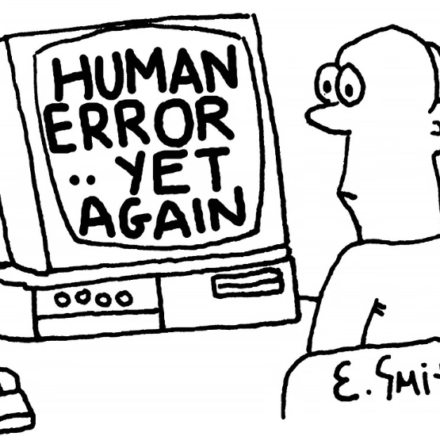
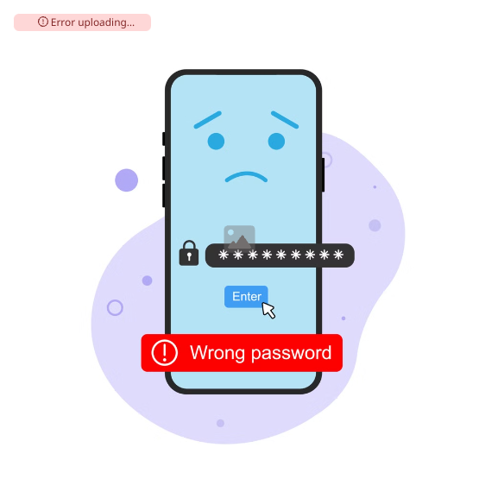

Error Handling and Security
Error uploading image.
Error Handling
PIN Attempts
Negative Amounts
The system is designed to handle various errors, such as invalid PIN attempts, negative transfer amounts, and insufficient funds. This ensures robust operation and protects against user mistakes.
To prevent unauthorized access, the system limits PIN attempts to three. After three incorrect attempts, the account is locked for 24 hours, safeguarding the user's funds.
The system prevents negative amounts in any transaction. This ensures accuracy and consistency in managing account balances and preventing unexpected deductions.

Slide 7
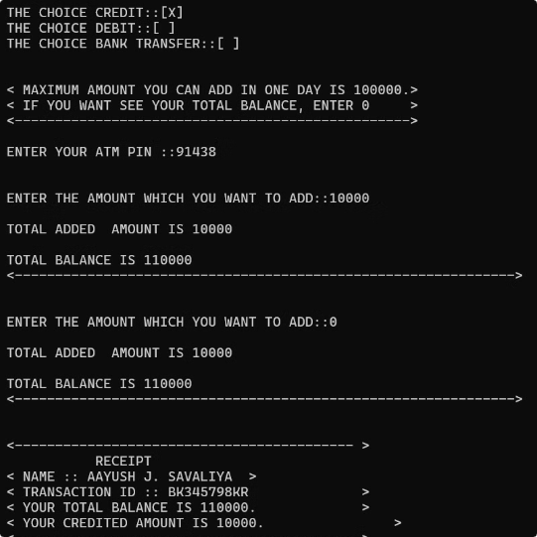
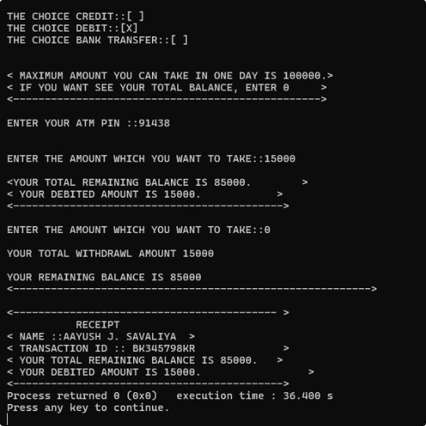
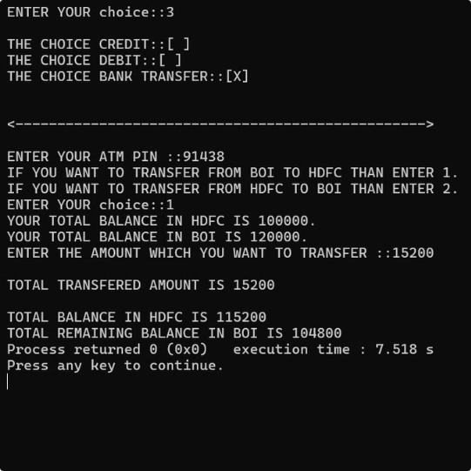
Outputs:
CREDIT
DEBIT
TRANSFER

Slide 8
Conclusion:
~ This program simulates basic ATM functionalities such as crediting, withdrawing, and transferring funds between accounts. It provides user-friendly options for these operations and validates user input through PIN verification and transaction limits.
~This program serves as a simple demonstration of ATM functionalities, emphasizing logical operations, condition handling, and user interaction in C programming. For practical applications, enhancements like dynamic PIN management, secure data storage, and multi-account support would be necessary.
THANK YOU !!

